Slide 1
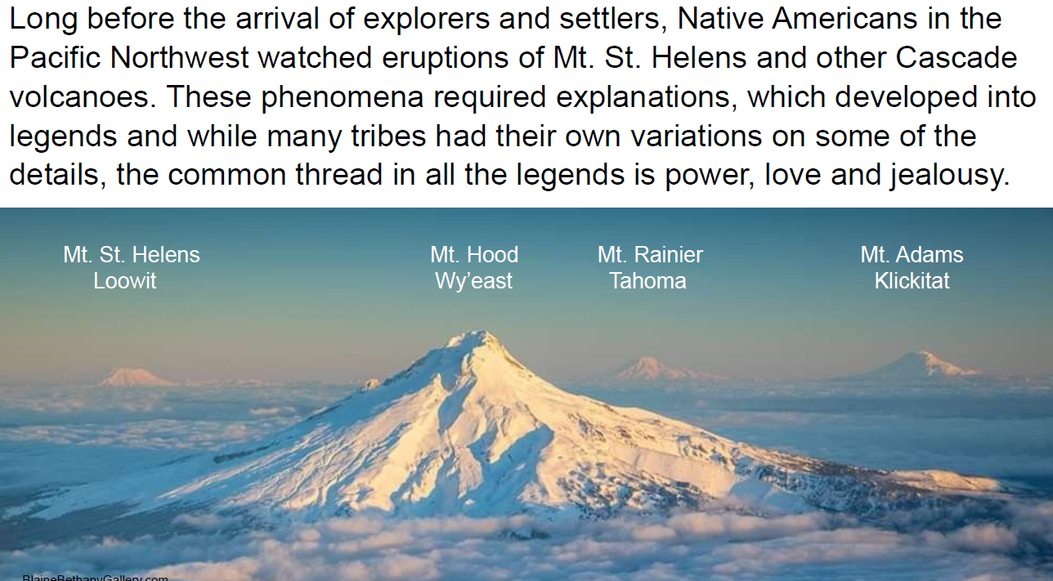

Slide 2
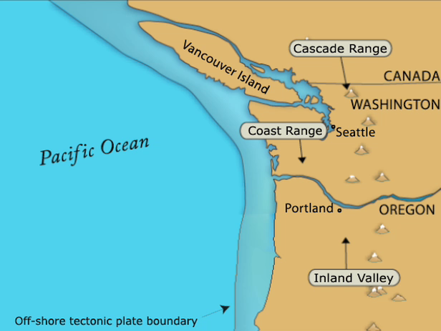

Slide 3
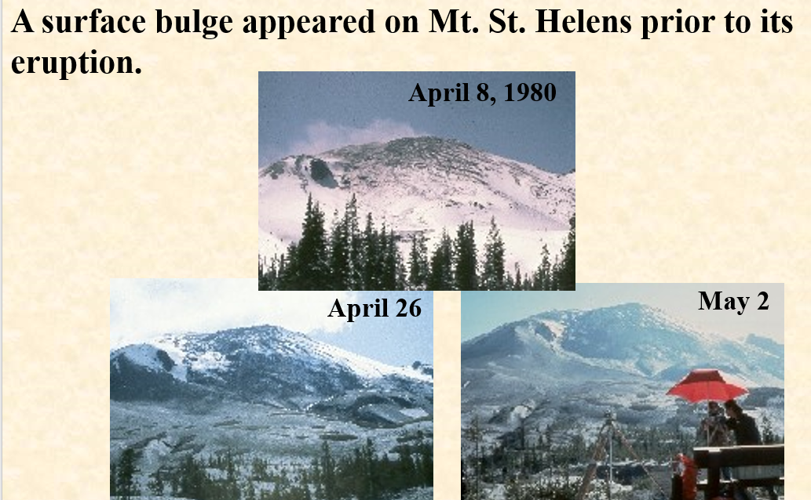

Slide 4
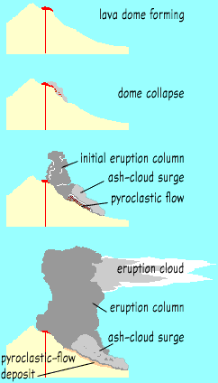

Slide 5
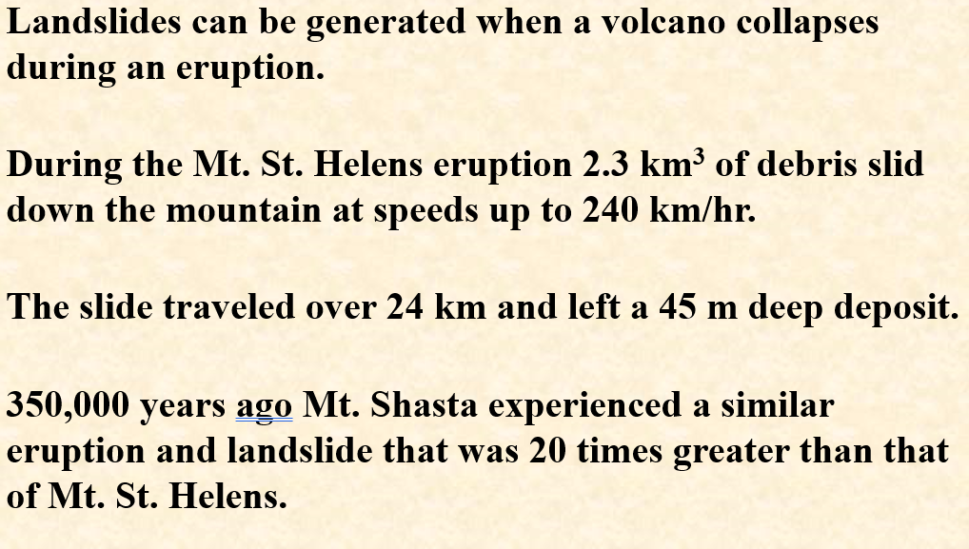

Slide 6
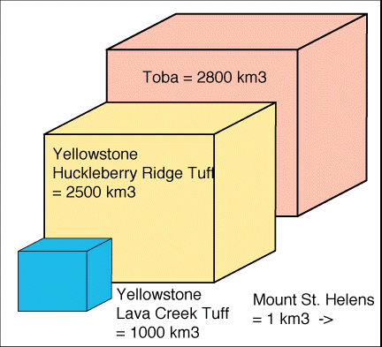
Super Volcanoes
While not defined officially, lets say any eruption that ejects 1000 km³ or more of pyroclastic material (i.e., VEI 8 or more).
According to M.R. Rampino super eruptions take place, on average, every 50,000 years. Three of the best known eruptions are compared below.

Slide 7
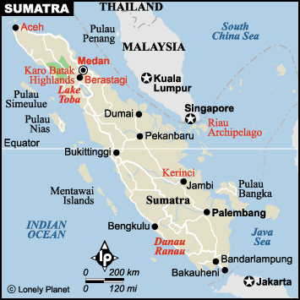
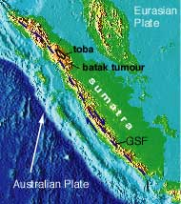
Toba: the world’s largest Quaternary caldera.
The Toba eruption reduced the human population from 100,000 individuals to as few as 3,000 individuals (97% of all humans were lost!). This reduction is termed the “human population bottleneck”.
The Australian Plate is subducting beneath the Eurasian plate at a rate of 6.7 cm/yr.

Slide 8
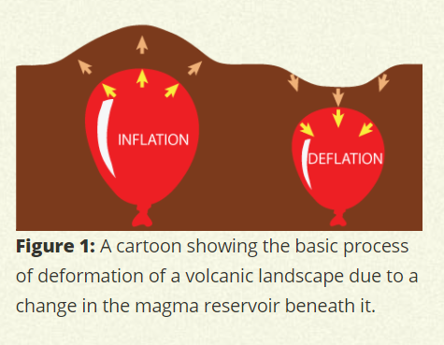

Slide 9
Closing Discussion (slides):
In addition to Mt. Hood, what other volcanoes are in the Portland area?
Mt. Tabor, Powell Butte, Cook’s Butte, La Butte, Boring Volcanics.
Where can the people of Oregon see “frozen” lava hundreds of feet thick?
The cliffs and walls of the Columbia River Gorge. Volcanic rocks are everywhere in Oregon!

Slide 10
What kinds of material erupt from volcanoes?
Gases, lava, ash, stones, broken rock, glassy rock.
Eruptions may also cause landslides. Underwater eruptions of lava form “pillows.”
Deep pools of lava may harden into “columns.”

Slide 11
Oregon Field Guide on OPB (Oregon Public Broadcasting) resource:
https://www.opb.org/news/article/mount-st-helens-eruption-anniversary-40-history/

